Slide 1
Municipal Redistricting and Reapportionment Update City of Hitchcock
Presented by: Denton Navarro Rocha Bernal & Zech, P.C.

Slide 2
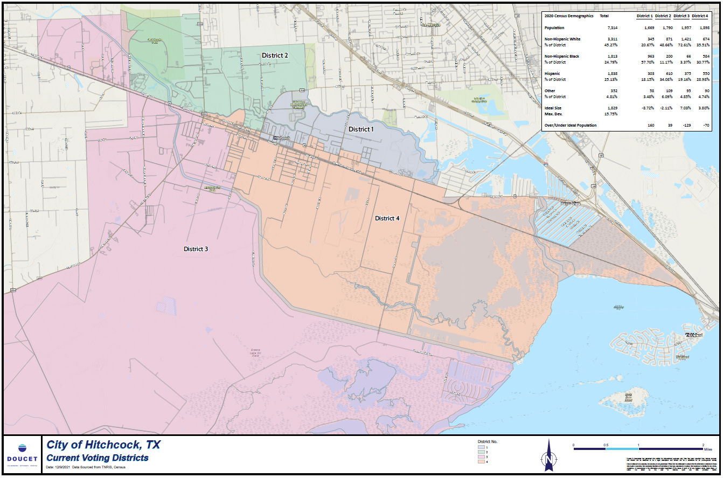
New Data and Current Map

Slide 3
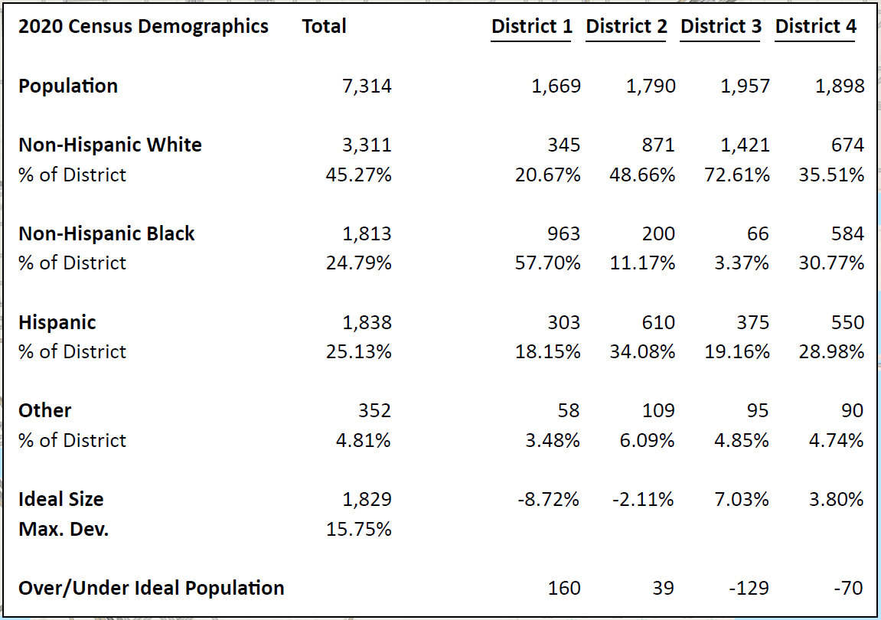
New Data and Current Map

Slide 4
Population by District
Total population is 7,330 making the ideal district size 1,833
District 1 1,669
District 2 1,790
District 3 1,957
District 4 1,914

Slide 5
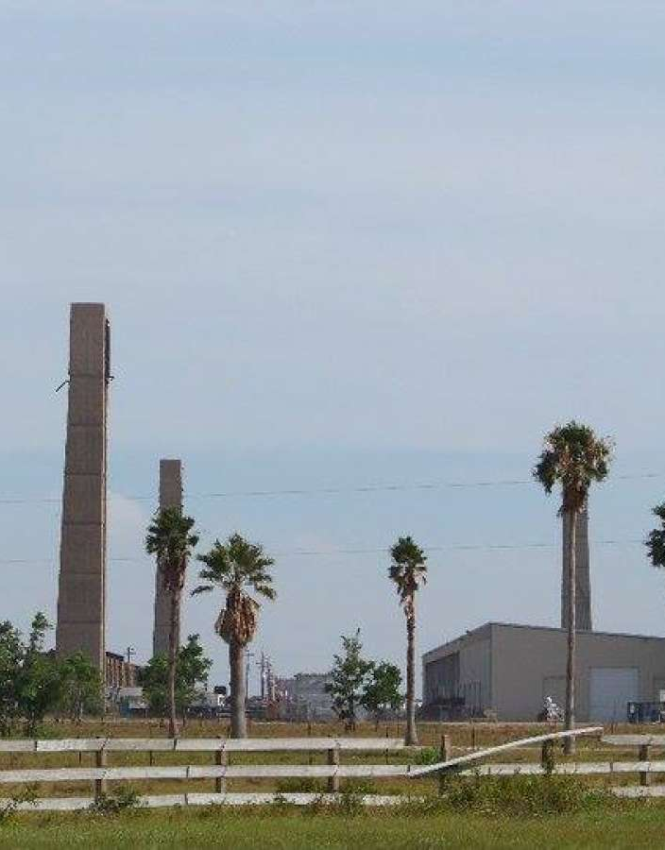
Calculating Deviation – District 1
The ideal district population is 1,833
The current district population is 1,669
This tells us we are 164 persons under the ideal size
That established a deviation of -8.92% for District 1

Slide 6
Calculating Deviation – District 2
The ideal district population is 1,833
The current district population is 1,790
This tells us we are 43 persons under the ideal size
That establishes a deviation of -2.32% for District 2

Slide 7
Calculating Deviation – District 3
The ideal district population is 1,833
The current district population is 1,957
This tells us we are 124 persons above the ideal size
That establishes a deviation of +6.79% for District 3

Slide 8
Calculating Deviation – District 4
The ideal district population is 1,833
The current district population is 1,914
This tells us we are 81 persons above the ideal size
That establishes a deviation of +4.45% for District 4

Slide 9
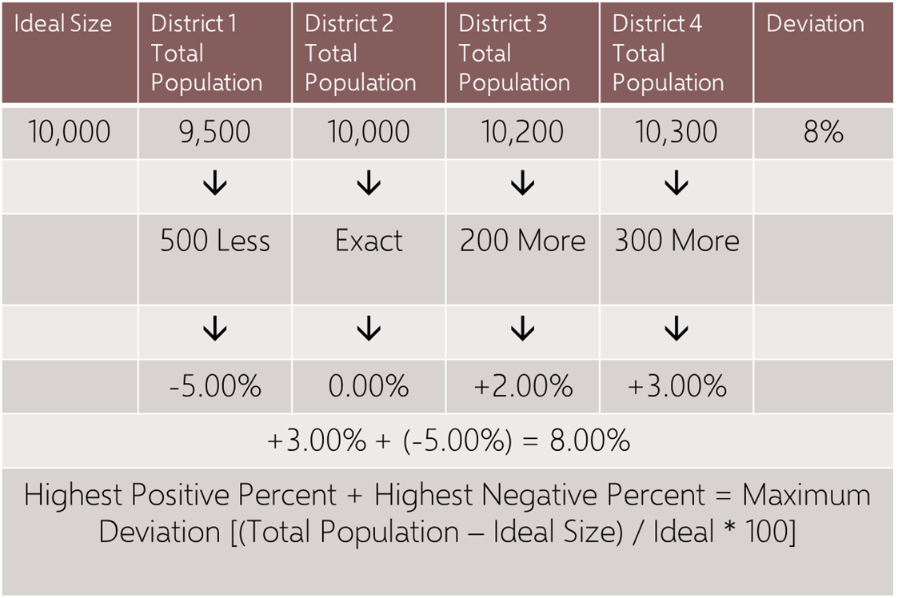
Calculating Deviation

Slide 10
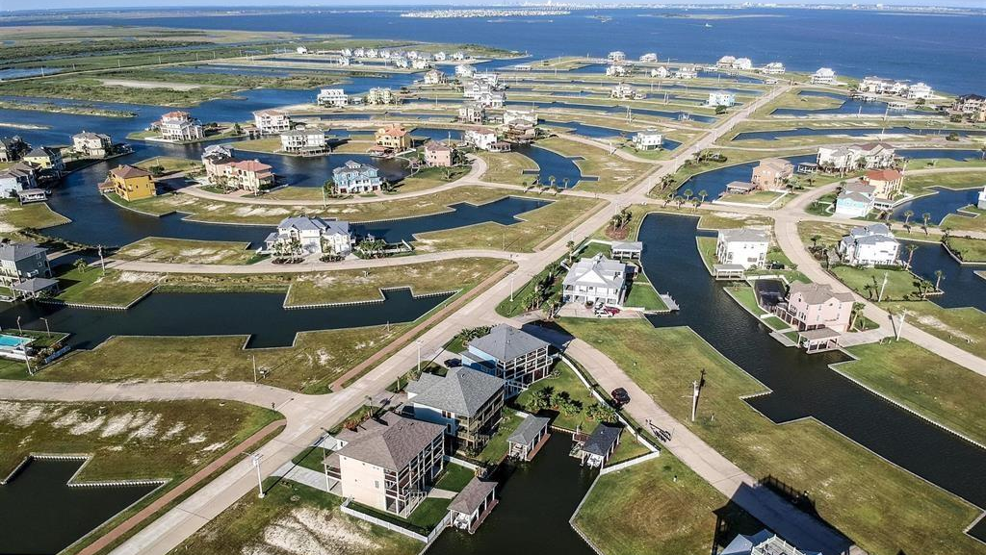
Hitchcock Maximum Deviation Calculation
Take the deviation of -8.92% for District 1
Add it to the deviation of +6.79% for District 3
Giving us a maximum deviation of 15.71%
The maximum deviation allowed is 10%

Slide 11
Application of Mandatory Criteria
No Discrimination
Not packed: Doesn’t push minority voters into few super-concentrated districts to dilute voice
Not cracked: Doesn’t split minorities into small pieces across several districts to dilute voice

Slide 12
Application of Discretionary Criteria
Contiguity
A district is contiguous if all the lines that create it are connected.
A district consisting of two or more unconnected areas is not contiguous
Compactness
Geographic – shape of the district
Functional – based on factors
Following Lines of Political Units
Following Geographical Boundaries
Communities of Interest
Travel within the district

Slide 13
Next Steps
Maps of the current district were reviewed with the new census data
New proposed maps were drawn based upon census data and city manager input following the mandatory and discretionary criteria
City Council will need to adopt new district maps by ordinance
A change in a boundary of a territorial unit of a political subdivision other than a county from which an office of the political subdivision is elected is not effective for an election unless the date of the order or other action adopting the boundary change is more than three months before election day. Tex. Elec. Code, § 276.006

Slide 14
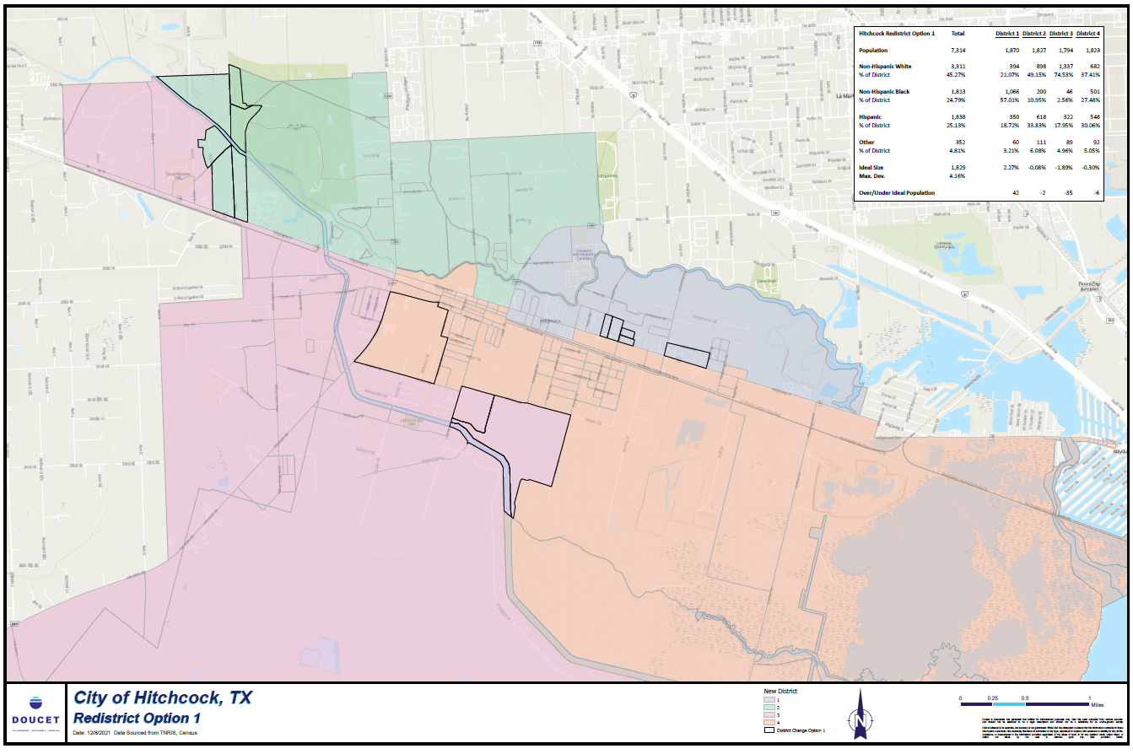
OPTION 1

Slide 15
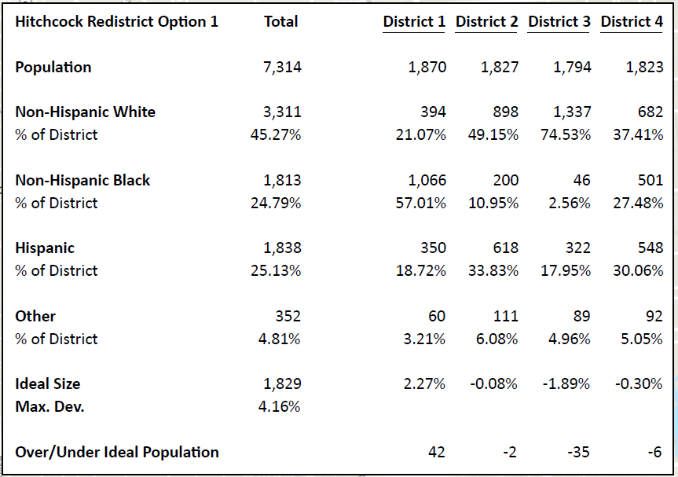
Option 1

Slide 16
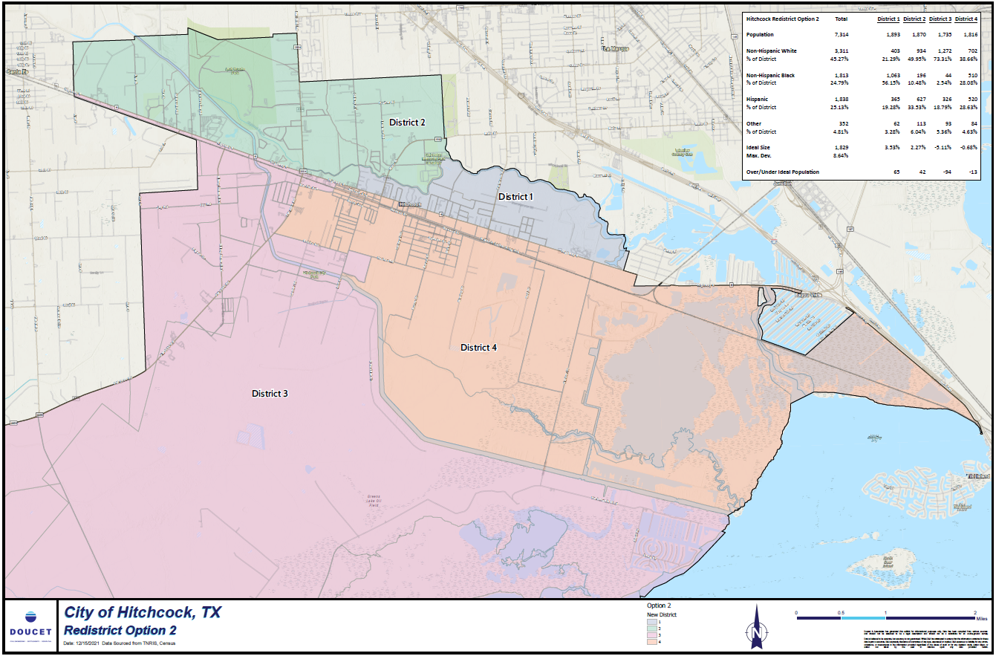
OPTION 2

Slide 17
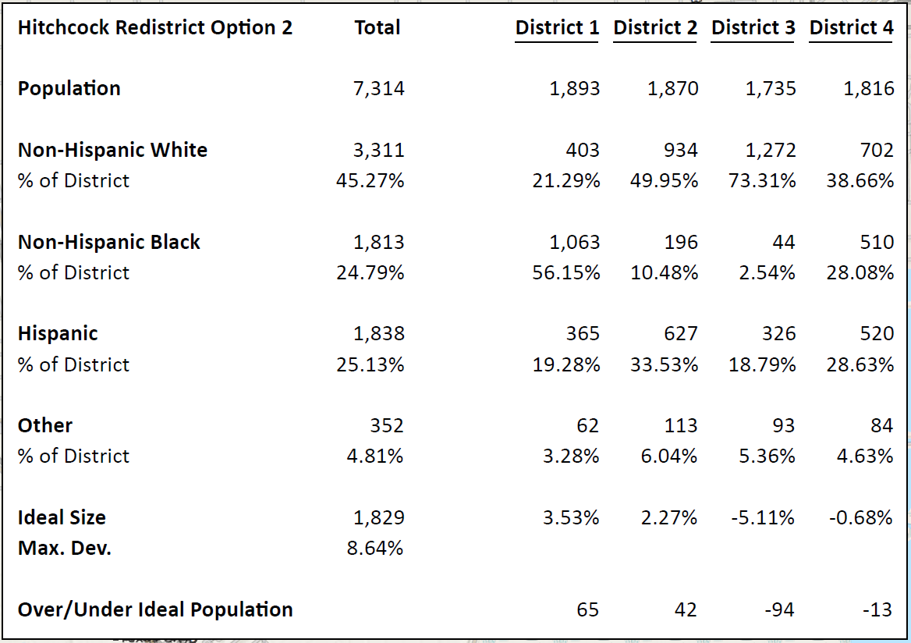
Option 2

Slide 18
Questions
T. Daniel Santee Partner
Denton Navarro Rocha Bernal & Zech A Professional Corporation 2517 N. Main Avenue San Antonio, Texas 78212 SA | AUS | RGV | TGC
Office (210) 227-3243 Fax (210) 225-4481
tdsantee@rampagelaw.com
www.rampagelaw.com

